Slide 1
John Nurminen Foundation
#itämeripäivä
#östersjödagen
#balticseaday
#läänemerepäev

Slide 2
Baltic Sea Day – always on the last Thursday of August
An annual theme day to inspire actions and thoughts, launched by the John Nurminen Foundation in 2019.
Goal is to inspire and invite everyone to join
make the Baltic Sea #1 topic on one day
give a chance to educate and learn
increase understanding and interest
lead by example and give hope
celebrate in all countries around the Baltic Sea
The Baltic Sea Day features activities, events, rallies and educational programs – and much more!
#itämeripäivä
#östersjödagen #balticseaday
#läänemerepäev

Slide 3
New tradition to complement other Baltic Sea Day related events – why?
Goal to engage general public
Goal to become a joint tradition in all countries around the Baltic Sea
Focus on activation and participation, concrete activities
Not restricted to ecological state of the Baltic Sea – culture and history in spotlight.
Not tied to any specific location – accessible to everyone also online
Sharing experiences in social media in key role

Slide 4
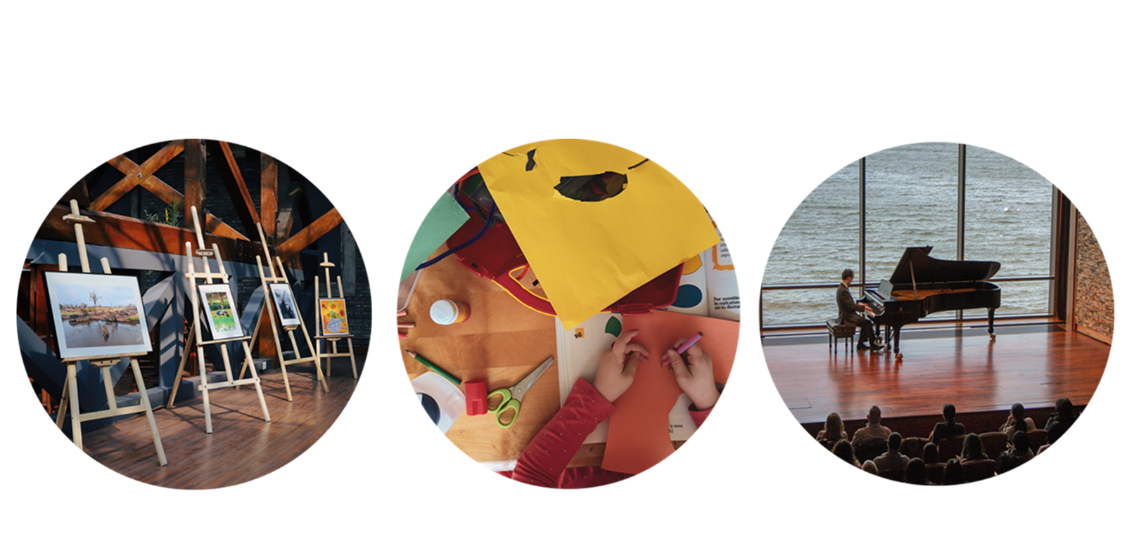
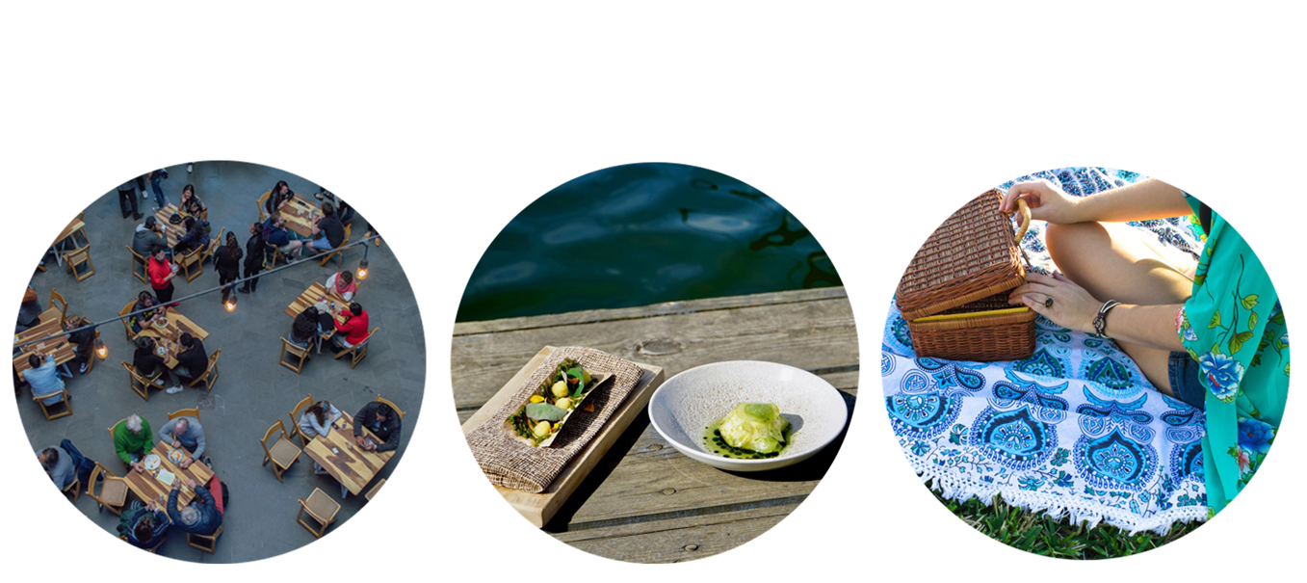
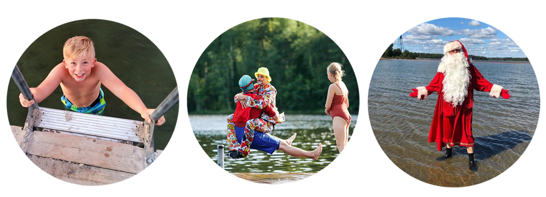
Key Baltic Sea Day campaigns
Three ready concepts for the Baltic Sea Day, everyone is welcome to participate
The goal is to make each of these go viral on the Baltic Sea Day
Baltic Sea Day key themes and campaigns
Food: Baltic Sea Menu
Water: Take the Plunge!
Culture: Baltic Sea Moment

Slide 5
1. Baltic Sea Menu
The easiest way to participate in the Baltic Sea Day is to enjoy a Baltic Sea-friendly meal!
On the Baltic Sea Day website https://itameripaiva.fi/en/activities/the-baltic-sea-menu/ you can find more information on the contents of a Baltic Sea friendly meal.

Slide 6
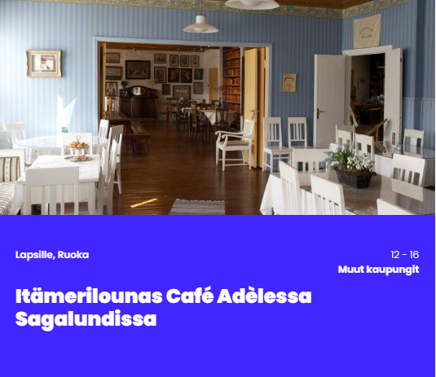
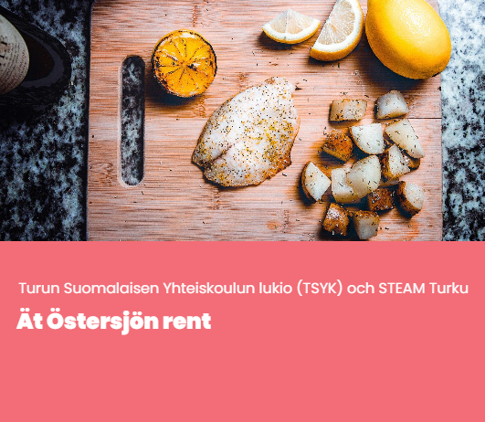
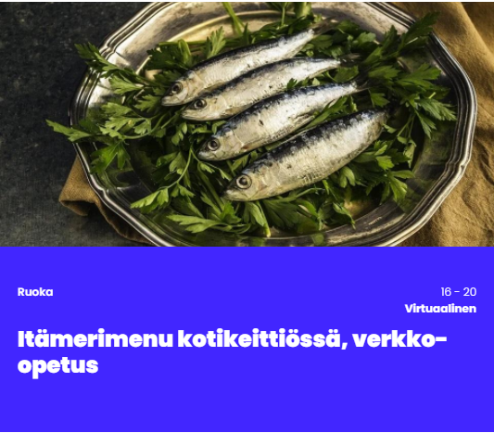
Baltic Sea Menu – how to participate?
For home chefs and gourmands
Dine in restaurants and cafés that serve Baltic Sea friendly food
Prepare – on your own or with friends – your own Baltic Sea menu
Restaurants, cafés, and staff canteens
Create a Baltic Sea friendly dish or even a full Baltic Sea Menu for your restaurant.
Create a takeaway picnic basket or menu kit to be cooked at home, using Baltic Sea friendly raw materials.

Slide 7
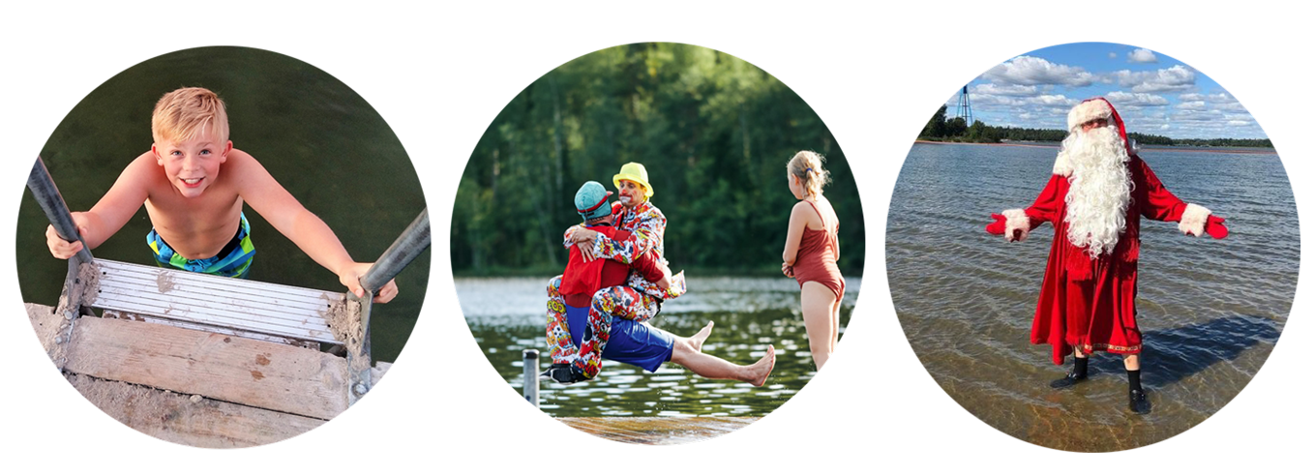
2. The Plunge
On Baltic Sea Day, we all take the plunge at 6 p.m.!
You can participate by any lake, river, pond or sea shore.
The idea is to enjoy the recreation posibilities and at the same time spotlight the ecological status of our waters

Slide 8
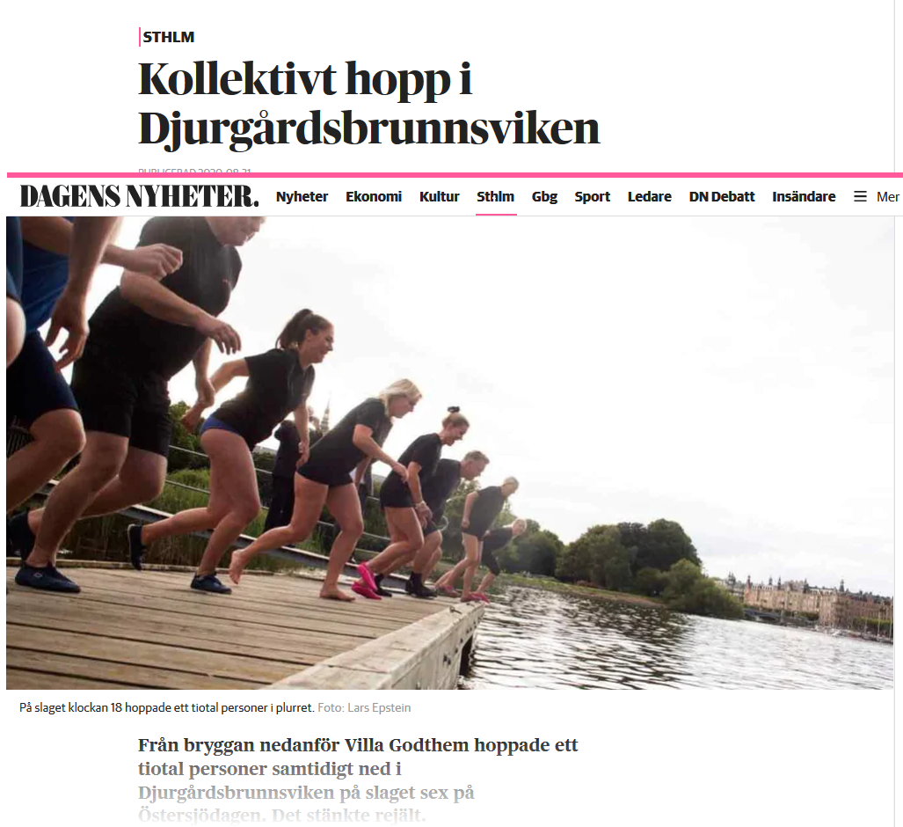
The Plunge – how to participate?
Previoius years:
Crowd plunge with dodsing and a swimming school.
Finnish Lighthouse Association organised a crowd plunge in lighthouses all over Finland.
Plunges also in Stockholm with staff, politicians, etc.
Challenge your co-workers, your sports club, or friends
Take care not to enter the water all on your own: when plunging, it is best to always have a plunging partner or a friend close by, looking after you!
Crowd plunge! It is also possible to organise a plunge for the public. The organiser is obliged to take care of the security and other arrangements.

Slide 9
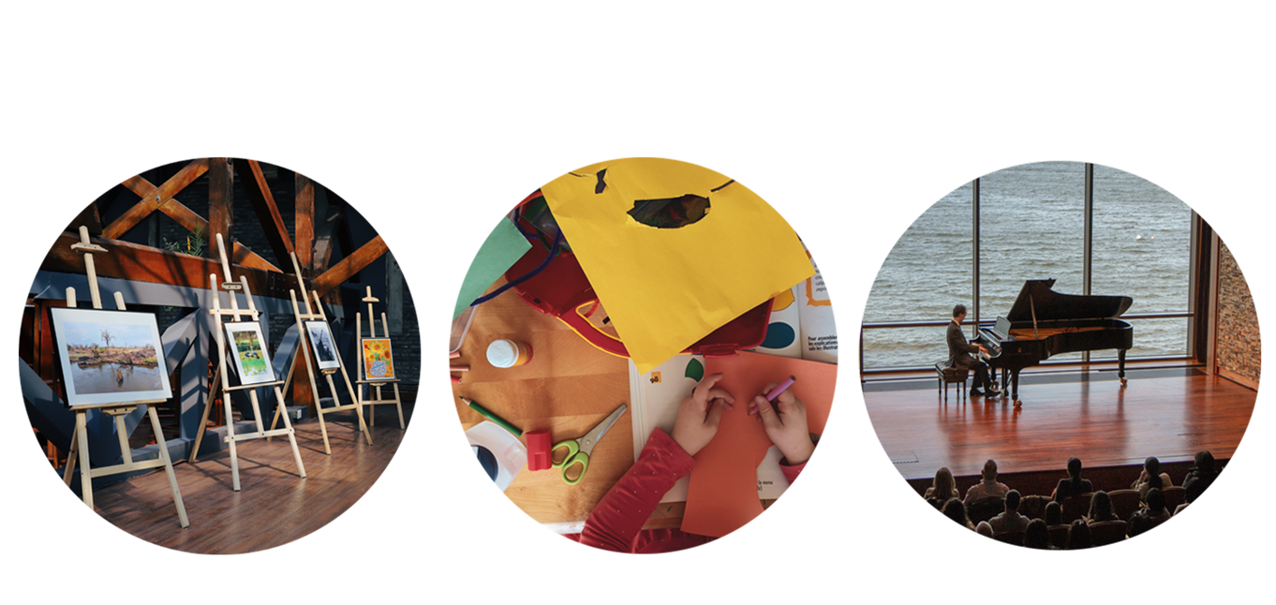
3. Baltic Sea Moment
Baltic Sea Moments are dedicated to the unique culture of our home sea.
You can enjoy a Baltic Sea Moment at any time during the Baltic Sea Day.

Slide 10
Baltic Sea Moment – how to participate?
Visit a marine-themed exhibition, read Baltic Sea themed literature, or listen podcasts or the story of the Tiny Roach.
On Baltic Sea Day museums, theatres and other stakeholders can organise interesting Baltic Sea-themed exhibitions, guided tours, workshops, and presentations.
Libraries can highlight the Baltic Sea Day with e.g. book exhibitions, reading suggestions, poetry and reading challenges, story hours, arts and crafts, and colouring activities.
Baltic Sea Moment for children
The Baltic Sea Day provides a Baltic Sea-themed story, featuring activities for children, for day care centres, schools, and homes. You can read or listen to the story on the Baltic Sea Day website.

Slide 11
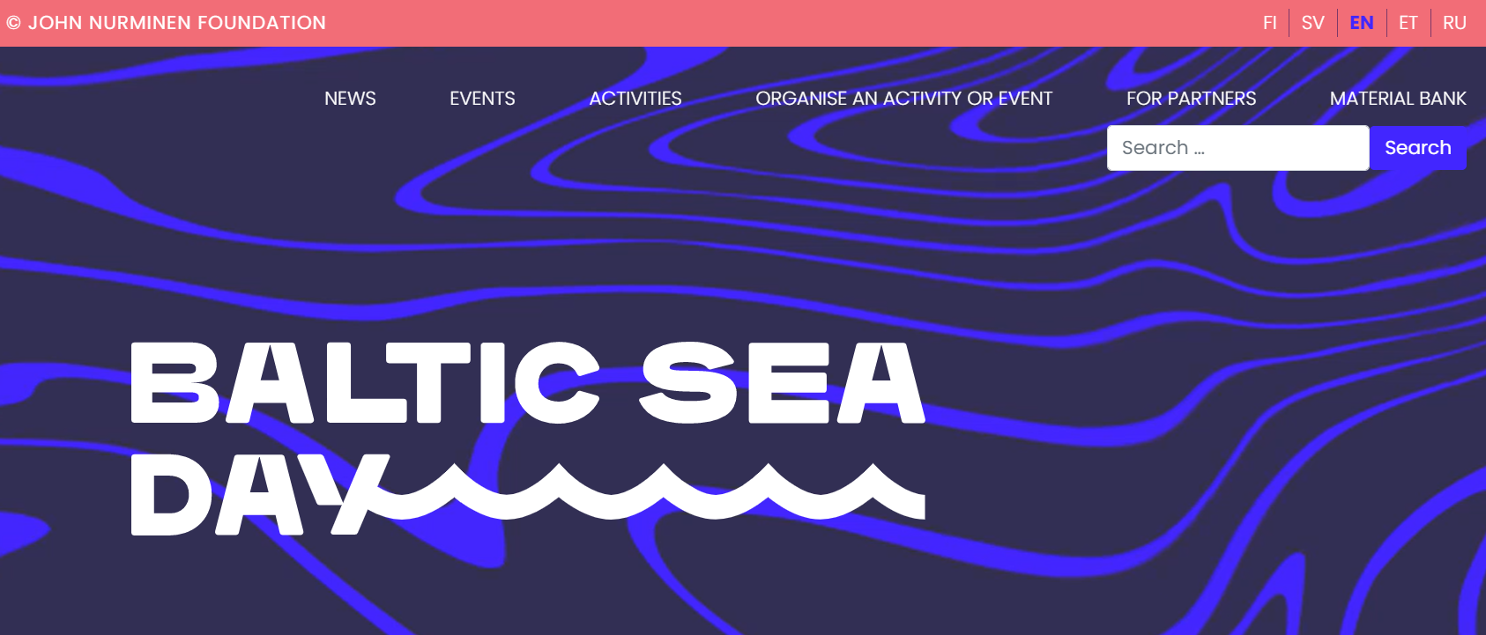
How to participate – more info from Baltic Sea Day website
balticseaday.fi
östersjödagen.fi
itameripaiva.fi/et/

Slide 12
Baltic Sea Day partnership and values
We commit to shared goals and a shared code of conduct: ”The Baltic Sea is more” – culture, environmental protection, experiences and adventure.
In our own operations, we comply with the principles of sustainable development.
We implement actions that make people’s eyes and minds turn towards the Baltic Sea.
We are a proud ambassador of the Baltic Sea Day, and we respect the Baltic Sea community and other partners of the Day.
We encourage all to join in!
Participation in the day is free (there is no participation fee).

Slide 13
Success measured and shown in growing number of partners
#itämeripäivä
#östersjödagen #balticseaday
Increasing awareness of the Baltic Sea Day
This is our common goal!
We follow social media and website statistics
Baseline questionnaire in fall 2021
”Partner index”
The number of committed partners grew to 230 in 2022
Let’s make it even bigger and set goal to 300!
”City index”
All cities are wellcome. In 2022 we celebrated in over 30 cities.
Let’s set the goal to 40!
One of the key success indicators of the Baltic Sea Day is for us to be able to communicate about the Baltic Sea in a way that engages new audiences and gets people interested in the Baltic Sea!

Slide 14
2022 highlights

Slide 15
Baltic Sea Day 2022 in numbers
Festivities in six countries..
..and in over 30 cities.
With over 250 partners..
..arranging over 230 registered activities.

Slide 16
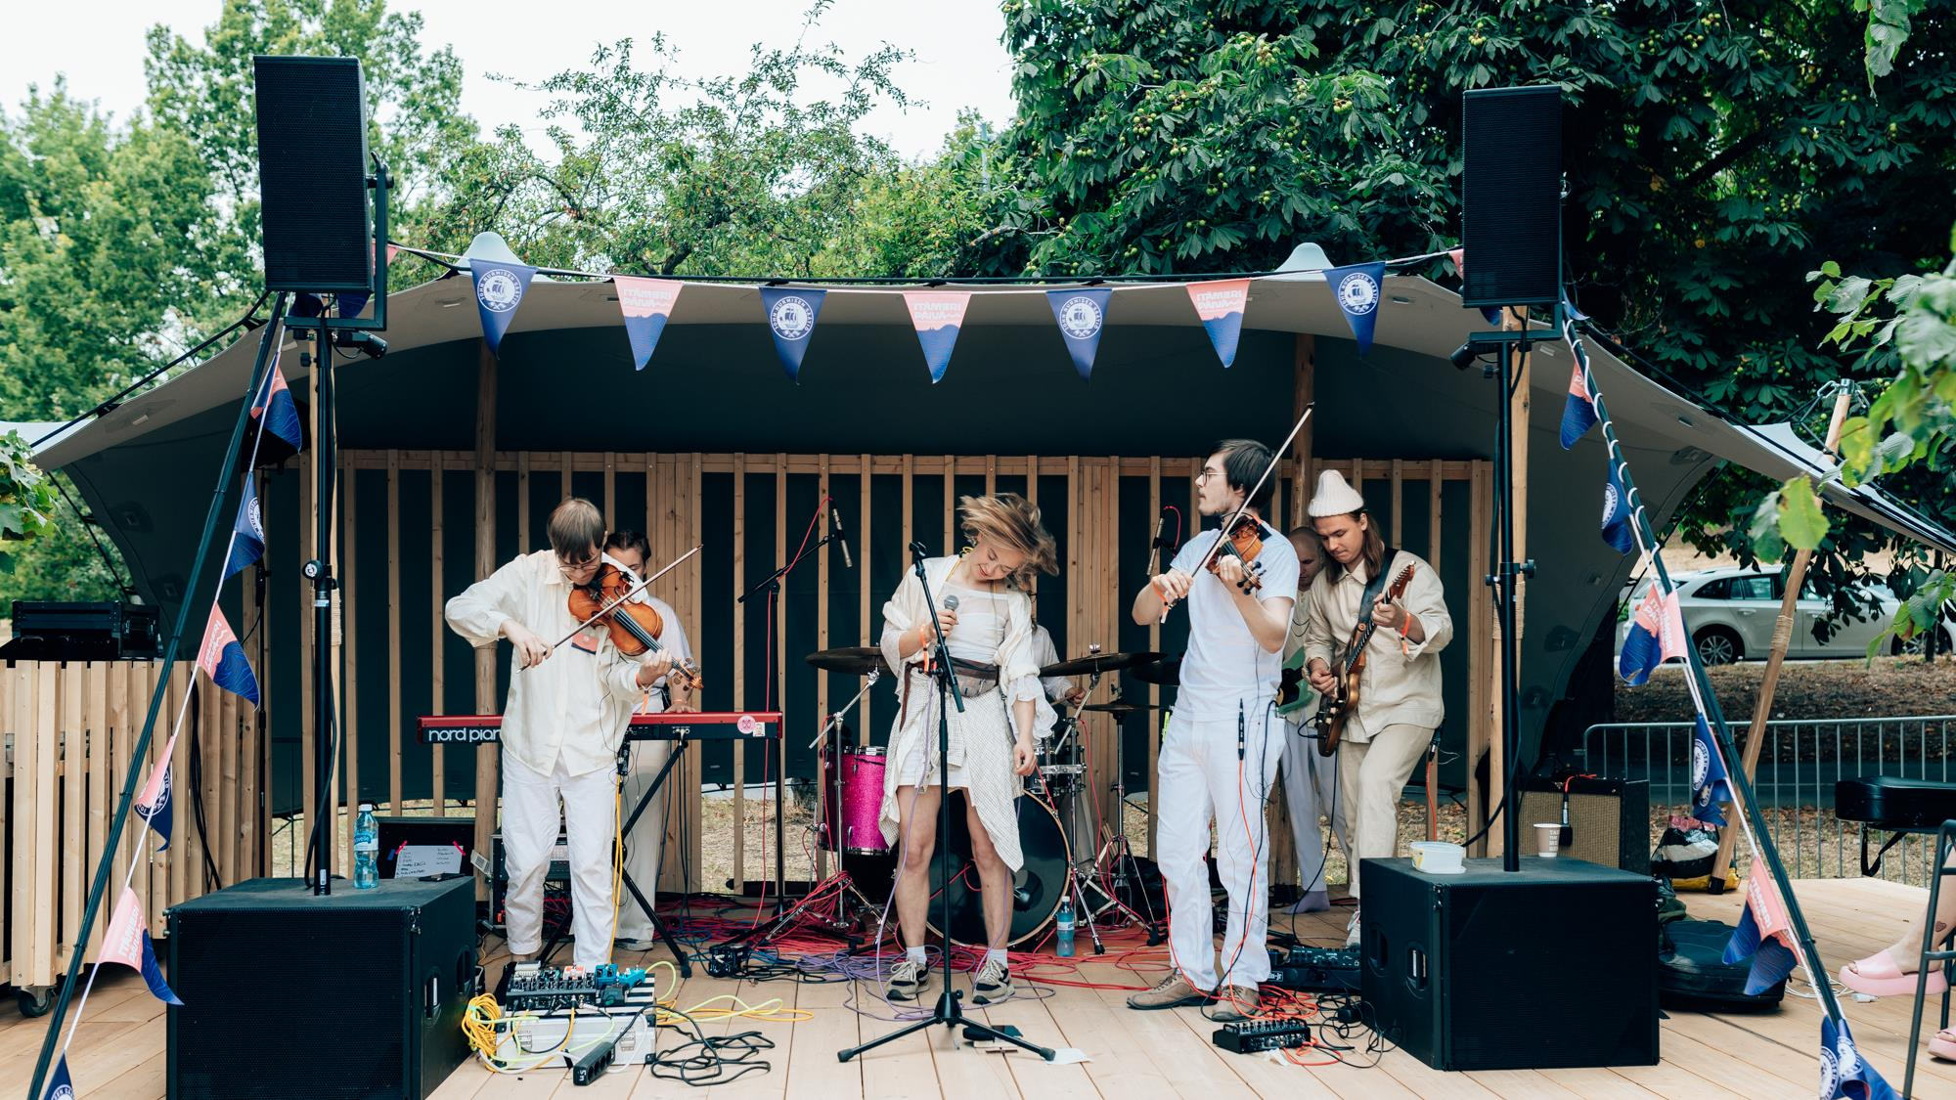
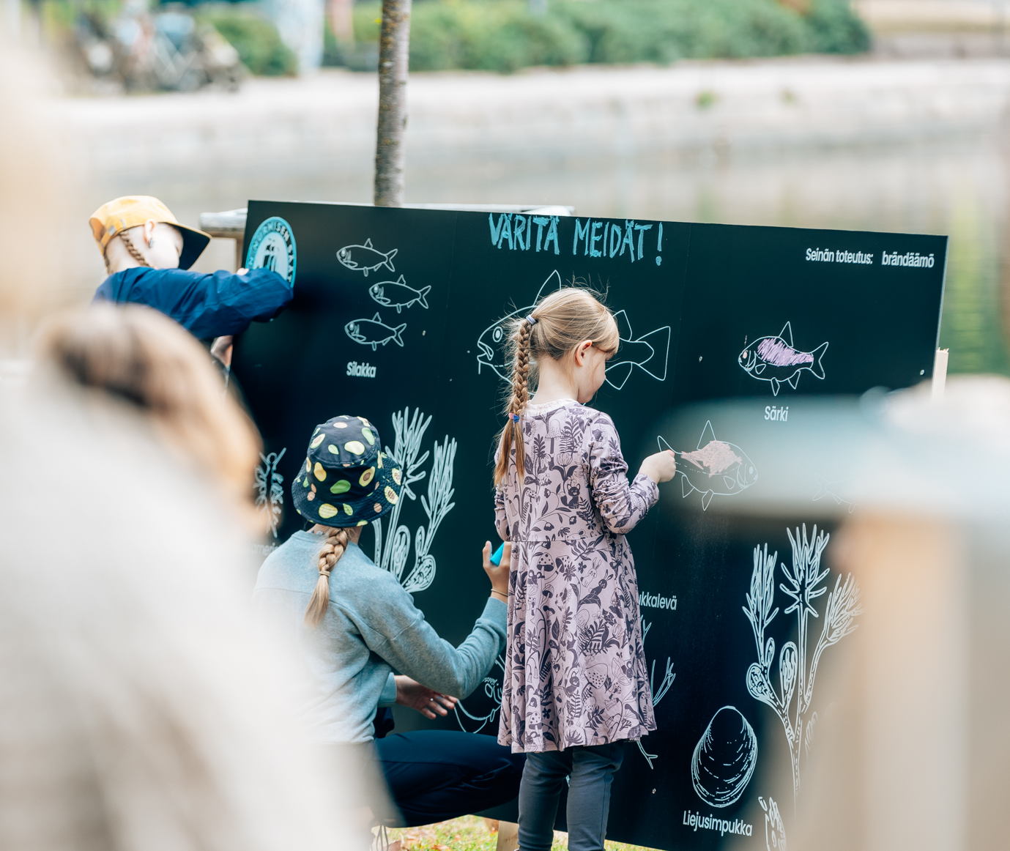
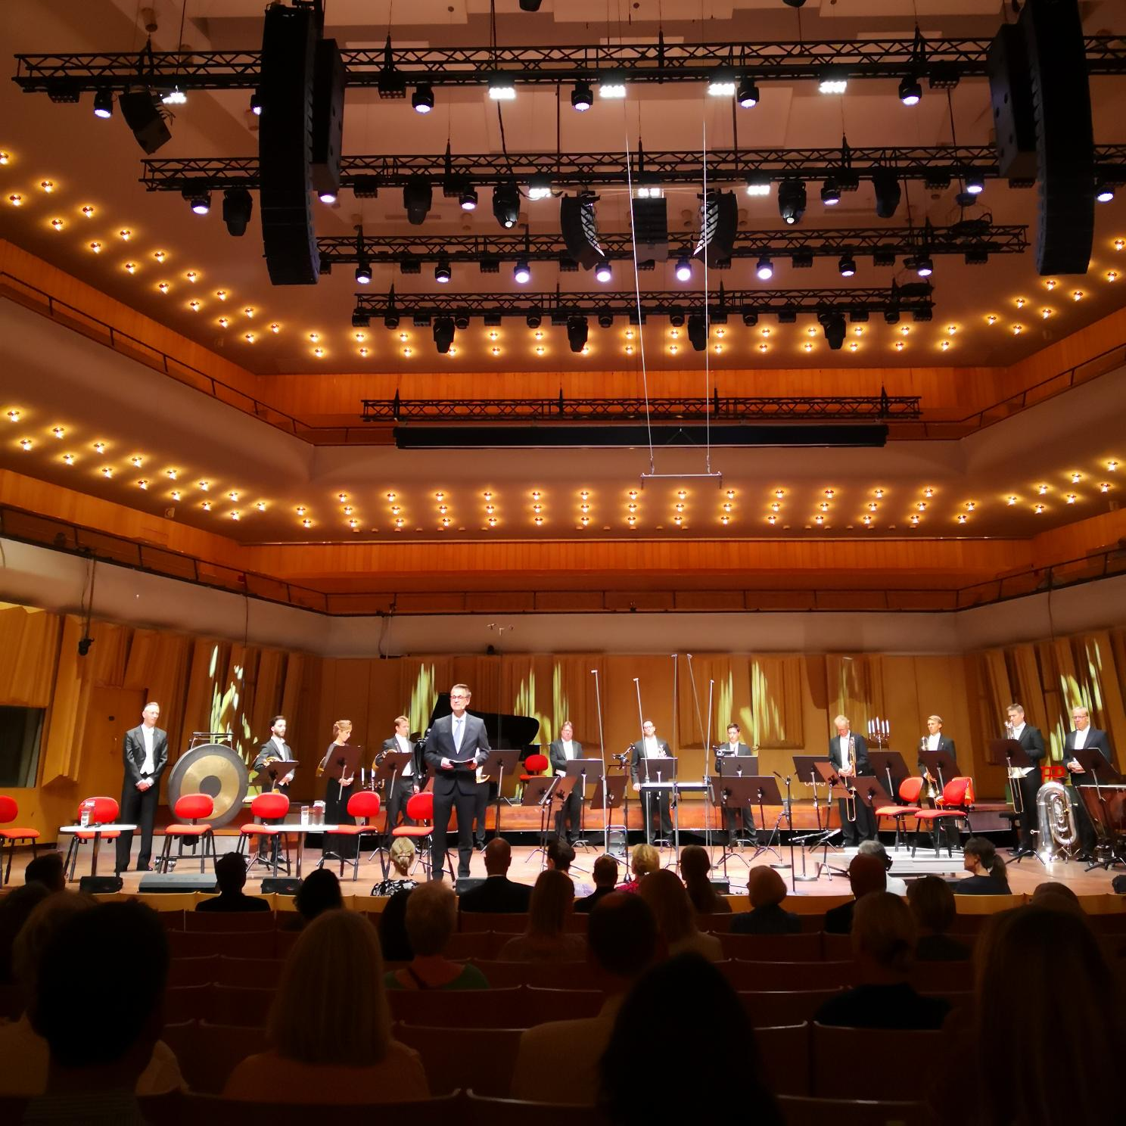
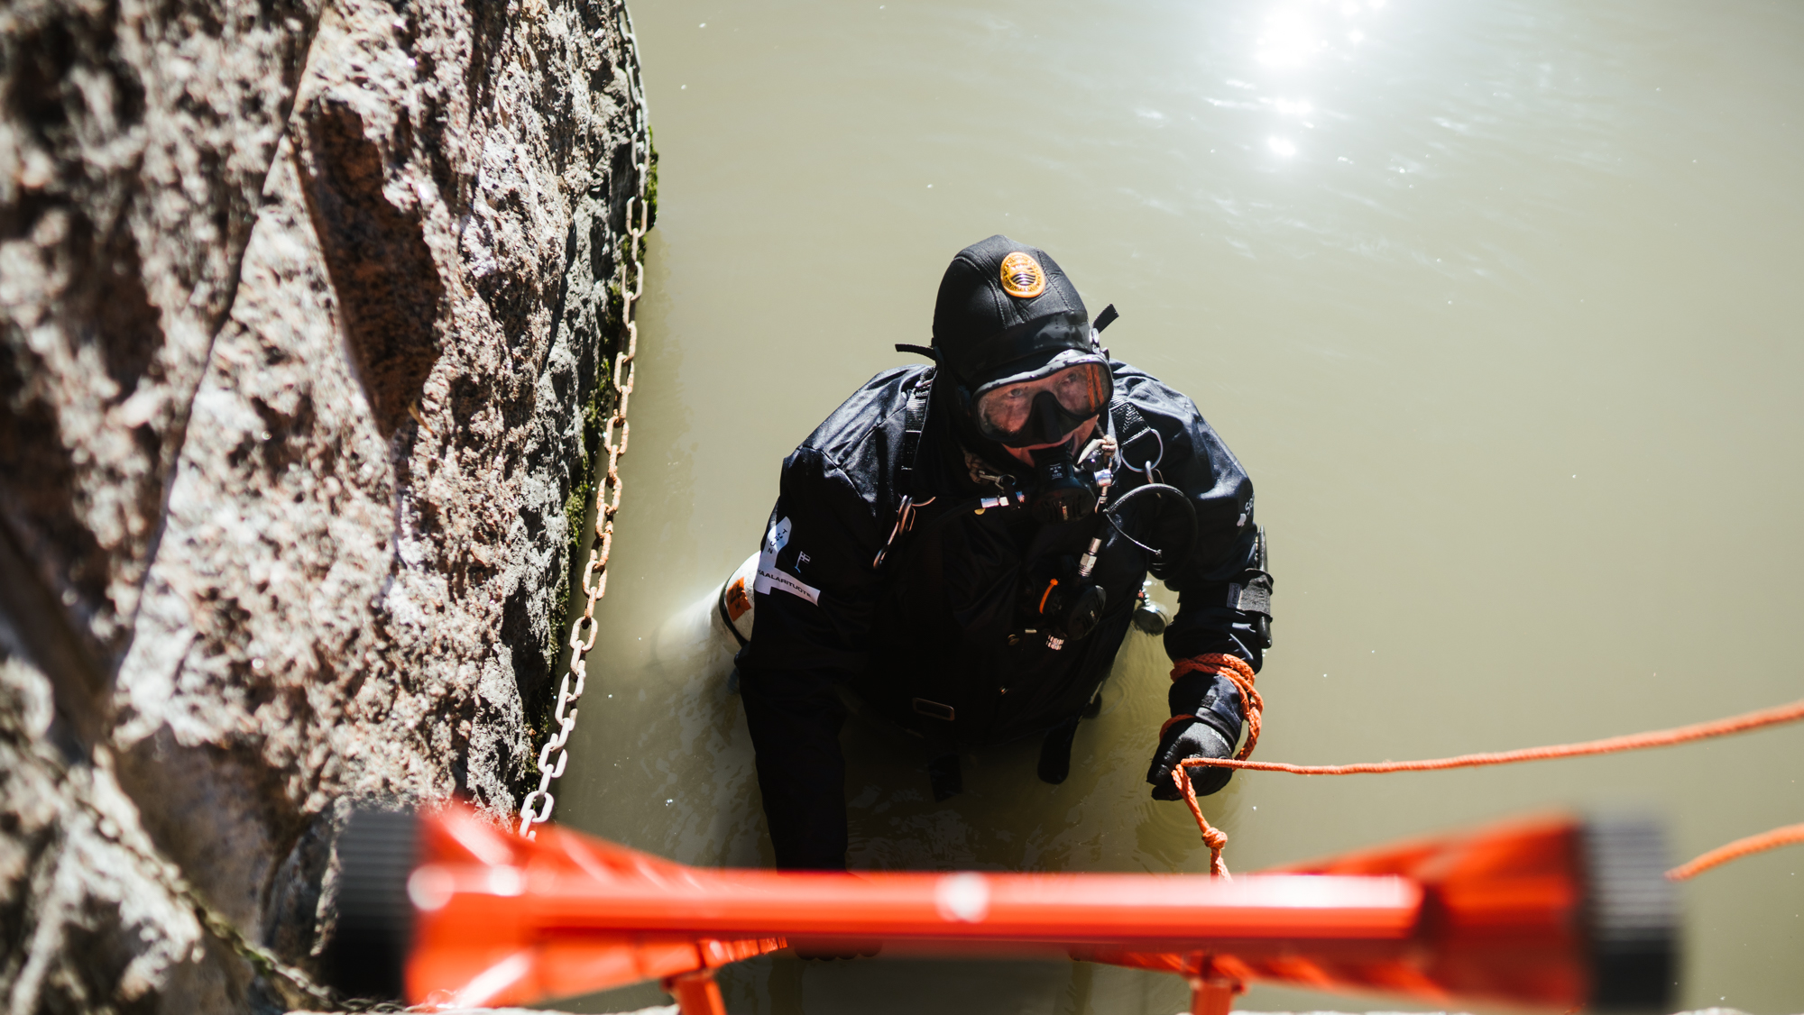
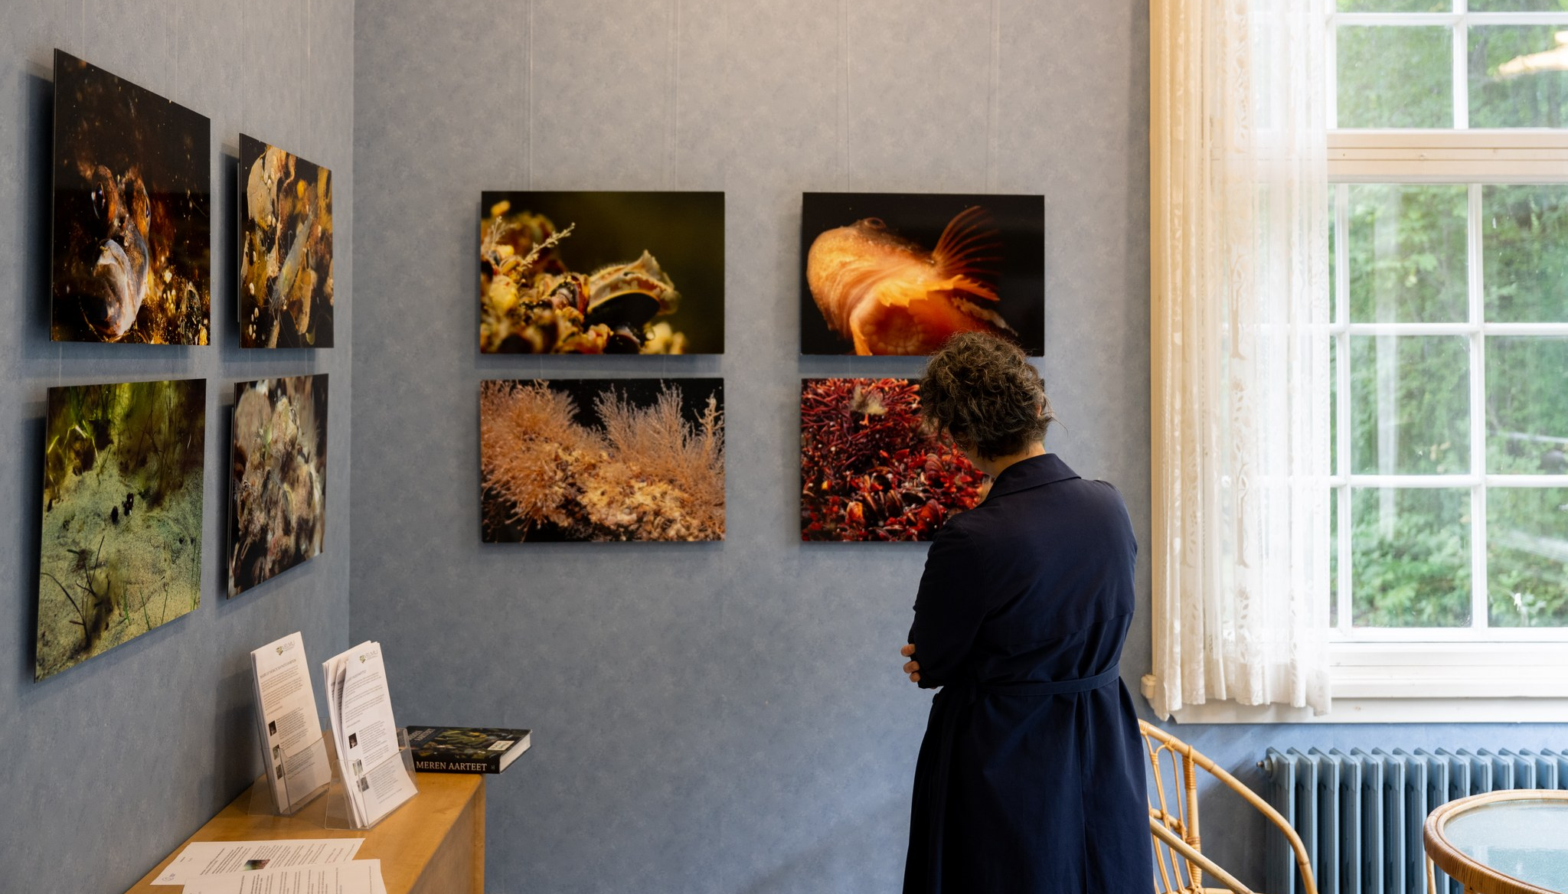
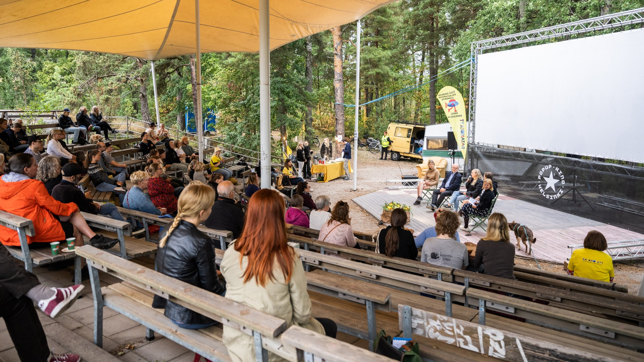
Pic: Petri Anttila
Pic: Ilkka Vuorinen
Pic: Petri Anttila
Pictures from Helsinki, Stockholm Turku
Pic: Ilkka Vuorinen
Pic: Ilkka Vuorinen

Slide 17
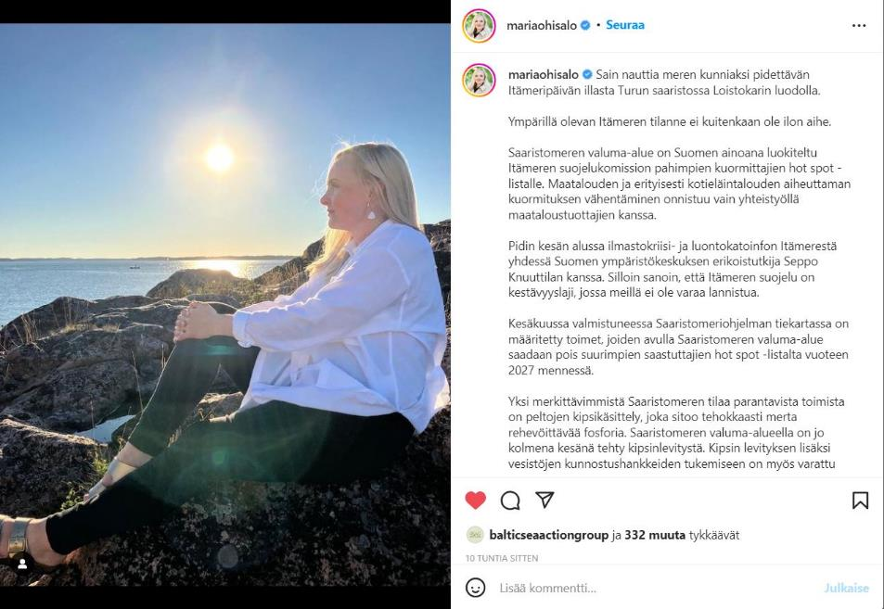
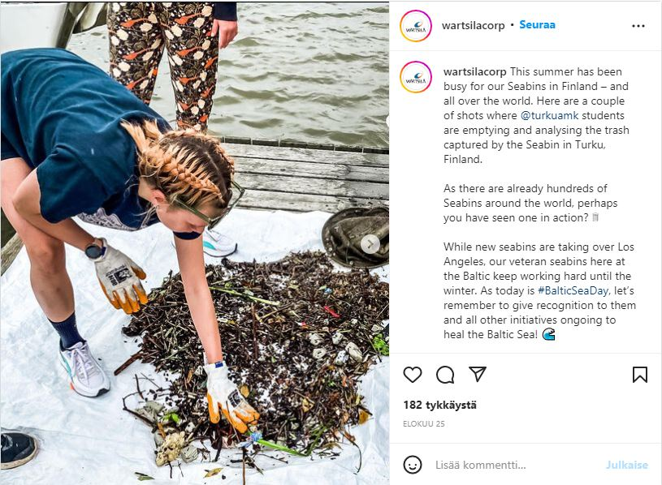
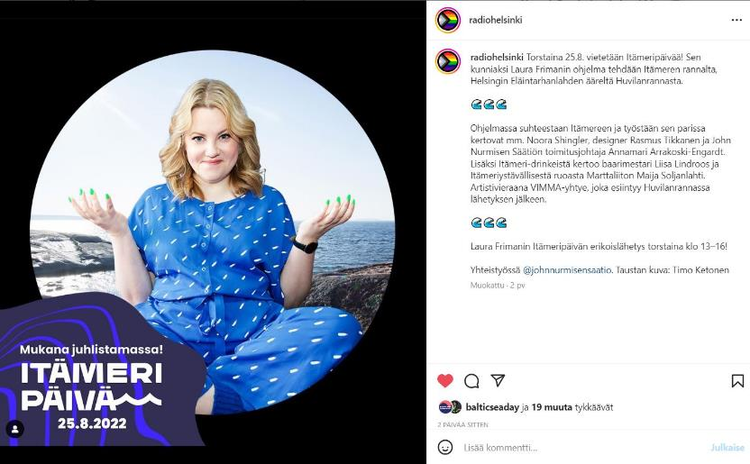
Instagram
Over 1000 stories and pictures on Baltic Sea.
More than 5 000 posts #itämeripäivä #ostersjödagen #BalticSeaDay

Slide 18
What next? Schedule for implementation in 2023
Regular newsletter - also published on website
Join in as early as possible, and publish your activity/event preferably by July 31st!
Social media marketing also in English and Swedish
Press release in August
22.8.22
2.2.
16.3.
31.8.
Baltic Sea Day 2022
Info session in Finnish
Info session in English
Info sessions on demand
Info sessions on demand
Newsletters
Baltic Sea Day
2023
#itämeripäivä
#östersjödagen #balticseaday

Slide 19
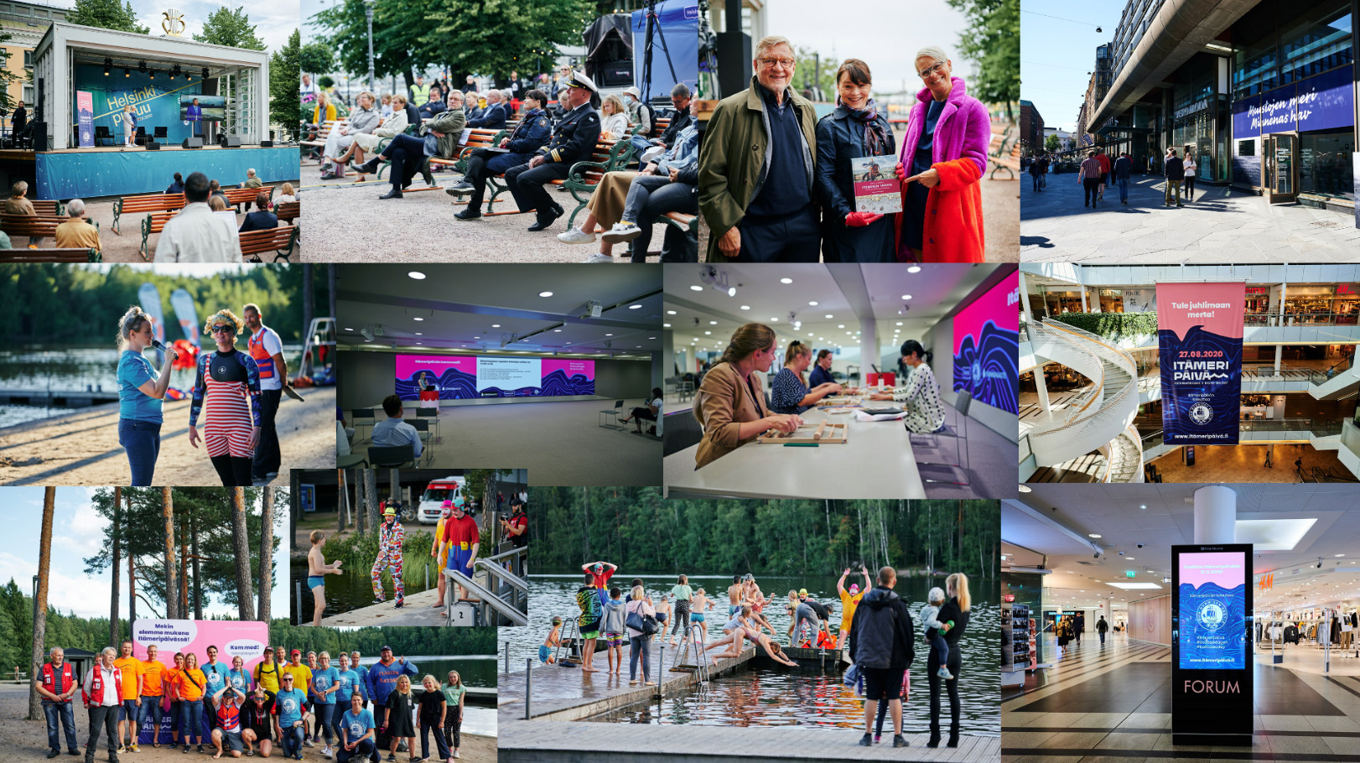
Your are welcome to join in the Baltic Sea Day 31st of August 2023!
Finland: Maija Soljanlahti, John Nurminen Foundation
Sweden: Madison Sauder, Race For The Baltic
Estonia: Liina Ergma, Finnish Institute in Estonia
Baltic countries: Elena Kaskelainen, John Nurminen Foundation
www.balticseaday.fi
Kuvat: Ilkka Vuorinen

